Slide 1
Industrial MANIPULATOR peripheral interfacing
PDE4431 Industrial Manipulators
Judhi Prasetyo & Bittu Scaria
Middlesex University Dubai

Slide 2
Abstract
An automation system will include different components, in addition to the robot, to provide the complete solution. These peripheral equipment have to communicate with robot or the master control system to provide an efficient Automated system. The lecture provides an introduction to the peripheral interfacing of an automation system including various communication protocols and PLC programming.

Slide 3
What are the peripheral equipment in a robot system
Peripheral equipment are the automation system components that are linked with a an Industrial Manipulator in a Automation system directly or indirectly.
In general we can define that majority of the system components falls into the Peripheral equipment category. The main difference is that what is assembled or attached with robot arm is not considered as peripheral. So As we have already covered that in our previous lecture they include;
Vision systems
Handling system
Process equipment
Tooling and fixturing
Assembly automation components
Safety and guarding.

Slide 4
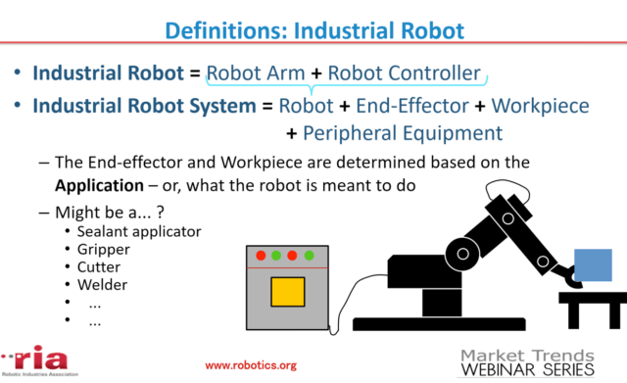
System Diagram

Slide 5
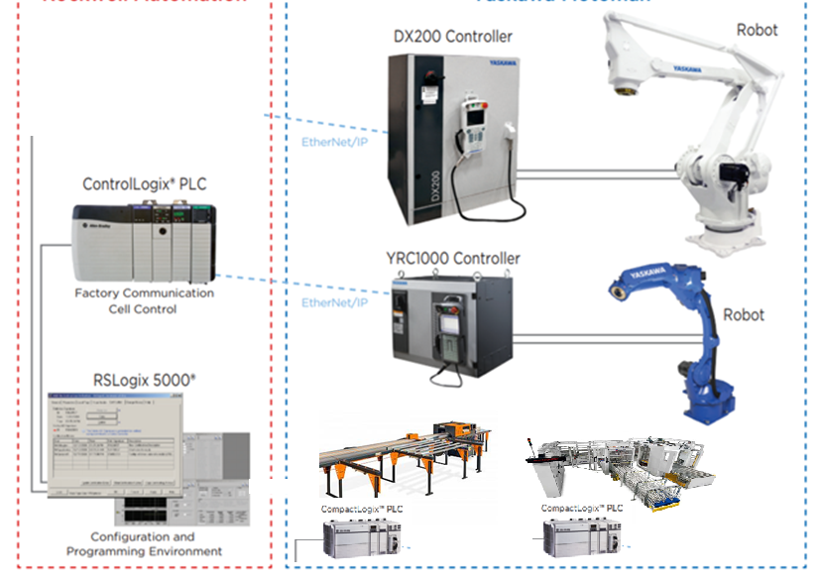
Schematic view of Peripheral Interfacing

Slide 6
Peripheral Interfacing
Process of establishing communication between the Robot and various system components/peripheral equipment in a Robot/Automation system can be defined as the term interfacing. Or simply we can define it as way, each peripheral equipment talk each other through a master control.
Communication is generally in the form of Input and Output signals what is exchanged between the individual equipment control system and the master device.

Slide 7
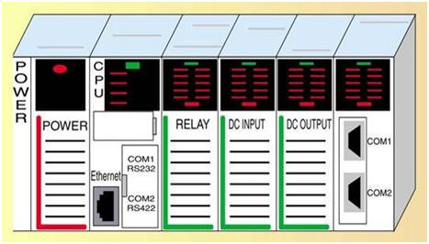
Programmable Logic Control(PLC)
PLC is an acronym for programmable logic controller. PLC is an industrial computer control system which controls devices by continuously monitoring the state of input devices and makes decisions based on a logic program to control the state of an output device. Incoming control signal is called an input. A signal going out of the PLC to control a field device is an output.
https://www.youtube.com/watch?v=PbAGl_mv5XI

Slide 8
Evolution of Interfacing and Controls
Prior to the present interfacing this functionality was provided by banks of hardwired relays, which were often complex, difficult to maintain and also difficult to modify for changes in the system. The PLC provided the same functionality but within software rather than banks of relays with the PLC being programmed using ladder logic, a programming method that replicated the functionality of relays and was, therefore, easy to understand and use.

Slide 9
PLC is a special form of microprocessor base controller that uses programmable memory to store instruction to control machines and processes, sends, receives, and processes data from and to the field devices. PLC monitors discrete things. It has a high speed response, so usually they're used in applications where high speed response is required, like manufacturing processes, industrial applications, and some traffic systems. Basically any application that needs a regulation of an input and an output.

Slide 10
Advantages of PLC
Reasons why PLCs are being widely used these days
They are user friendly and easy to operate
They eliminate the need for hard wired relay logic
They are fast
It is suitable for automation in industries.
Its input and output modules can be extended depending upon the requirements

Slide 11
PLC and Robot System
Within smaller robot systems, it is also feasible for the robot to provide the same functionality; therefore, a PLC may not be required. This would provide a lower-cost solution but is not always preferred because it becomes necessary for the customer’s personnel to access the robot programs and can be perceived as too complicated. They may be more comfortable accessing a PLC, due to their greater experience with them; therefore, PLCs are often included to maintain a separation between the robot and its programme and the overall system control. On larger systems, for example, with multiple robots, a PLC is normally preferred as one piece of equipment which can provide the overall control rather than being dependent on the controls being distributed across a number of different elements of the system.

Slide 12
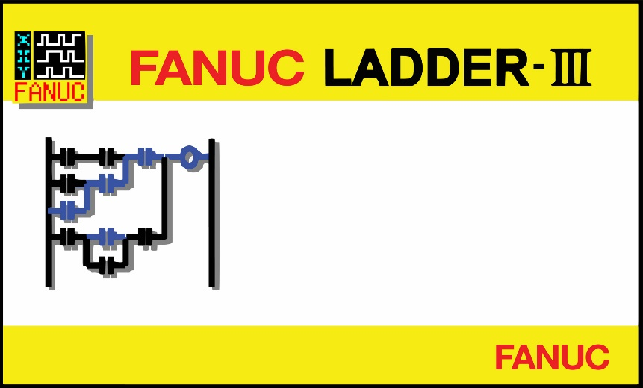
Example
Fanuc has inbuild PLC named PMC(Programmbale machine controller).This can be used to substitute a minor PLC functions. This is incorporated with robot controller hence no separate hardware are used but only a software to program the PMC Ladder.
PMC uses a FANUC internal CPU and is programmed via FANUC Ladder – III software. No additional hardware is required to use PMC. It is a virtual PLC that operates from within the already existing FANUC CPU

Slide 13
At the basic level the various items of equipment within the cell are interfaced to the PLC via digital I/O. Sensors are often located throughout the system to check the operating sequence and ensure a step has been completed prior to moving to the next step. These sensors might be located on conveyors to ensure parts are in position, on fixtures to ensure all parts are loaded correctly or within grippers to check parts have been picked up and put down.
Robots would also provide signals to the PLC at appropriate points to indicate where they are in their programme as well as waiting for signals from the PLC before moving on to the next step.

Slide 14
Remote I/O Modules
In addition it is also possible to locate I/O blocks remotely from the host device, the PLC, or the robot controller. For example, an I/O block could be mounted on a fixture to connect to all the sensors and any actuators on the fixture. These connections may be via individual wires. The signal to the host device from the I/O block may then be transmitted via a single wire; therefore, reducing the wiring from the fixture to the host. It may reduce cost, particularly if significant distances are involved, but it does improve reliability as well as ease of maintenance and repair.

Slide 15
Communication Protocols in PLC
Using discrete I/O can lead to a large number of signals being routed around the cell. Both robots and PLCs are equipped with I/O blocks that typically each handle 16 inputs and 16 outputs. If a large number of signals are required this can lead to a large number of I/O blocks both within the robot and PLC and there are limits to the number of I/O blocks that can be fitted. Systems with large amounts of I/O are also more expensive to install and more complex to maintain. To alleviate this problem, networks were developed to define standards for the interfacing of equipment with the intention of ensuring compatibility between different pieces of equipment.

Slide 16
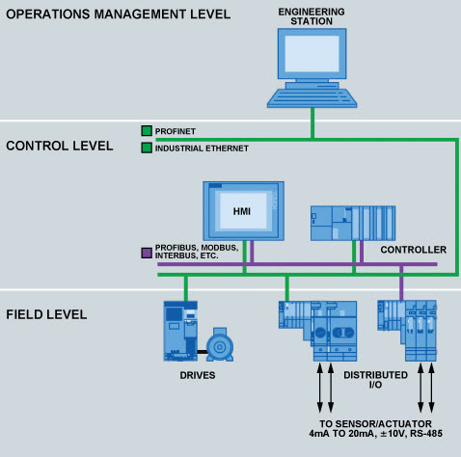
Since the time of PLC, various networks have been defined and used including Profibus and Ethernet. Unfortunately there are still some challenges as the major suppliers of PLCs tend to support a specific version of a network, reducing compatibility with the products aligned with their competitors.

Slide 17
definition
The communication protocol is a set of rules that govern data communication.
In other words, the communication protocol acts as an agreement between two or more communicating devices.
By using the communication protocols, two devices connect and communicate with each other.
Without communication protocol, devices can only be connected but not communicated.
Ethernet
Profibus
Device Net
I/O Link
RS-232
RS-485
Modbus
Point to Point (PPI)
Data Highway (DH)
Control Net

Slide 18
Characteristics of PLC Communication
These are the foremost protocols used for the PLC and other network connections. These protocols are supported by different PLC software brands.
The communication protocols are dependent upon three fundamental parts as mentioned below.
Baud rate
Network length
Number of nodes

Slide 19
Parameters
Sr. No. | Protocol | Baud Rate | Network Length | Number of Nodes
1 | Ethernet | 100 Mb/s | Few Kilometers (based on the type of Ethernet) | 255
2 | Profibus | 5- 12 Mb/s | 15 Km | 127
3 | RS-232 | 19.2 Kb/s | 10 m | 1
4 | RS-485 | 10 Mb/s | 1.2 Km | 32
5 | MPI | 19.2 – 38.4 Kb/s | 50 m | 32
5 | PPI | 187.5 Kb/s | 500 m | 1
6 | DH | 230.4 Kb/s | 3.048 Km | 64
7 | Control Net | 5 Mb/s | 30 Km | 99
8 | Device Net | 500 Kb/s | 0.487 | 64
9 | USB Adapter | 57.6 Kb/s | 10 m | 1
10 | PC Adapter | 9600 Kb/s | 15 m | 1

Slide 20
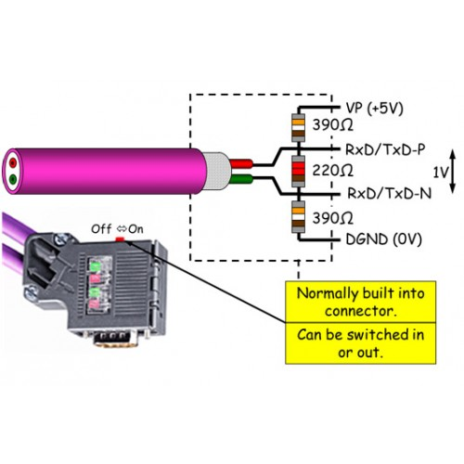
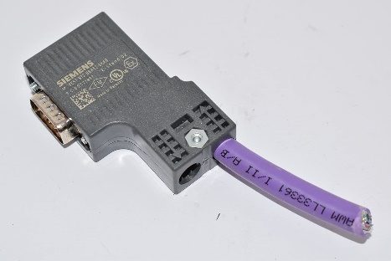
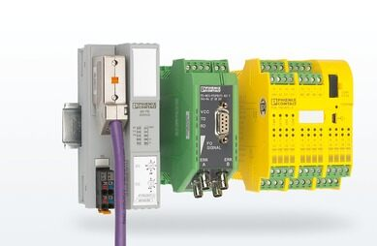
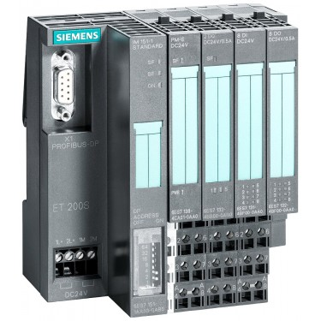
Profibus
https://www.youtube.com/watch?v=zJDsEqCyTqc

Slide 21
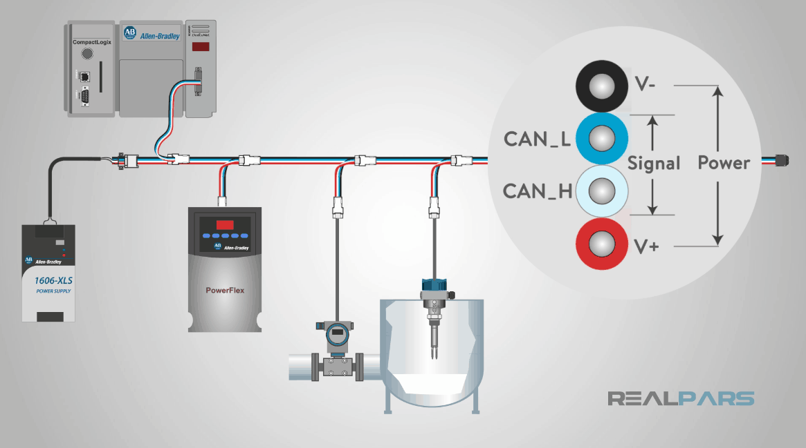
DeviceNet
DeviceNet was originally developed by Allen-Bradley which is a Rockwell Automation brand, and they decided to share this new technology with others and make it an open network.
https://www.youtube.com/watch?v=acnpobFi5qg

Slide 22
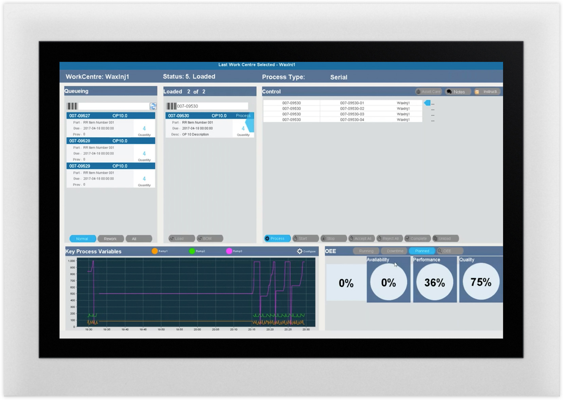
Human Machine Interface(HMI)
A Human-Machine Interface (HMI) is a user interface or dashboard that connects a person to a machine, system, or device. While the term can technically be applied to any screen that allows a user to interact with a device, HMI is most commonly used in the context of an industrial process.
Although HMI is the most common term for this technology, it is sometimes referred to as Man-Machine Interface (MMI), Operator Interface Terminal (OIT), Local Operator Interface (LOI), or Operator Terminal (OT). HMI and Graphical User Interface (GUI) are similar but not synonymous: GUIs are often leveraged within HMIs for visualization capabilities.
https://www.youtube.com/watch?v=kujHQgK352o

Slide 23
In industrial settings, HMIs can be used to:
Visually display data
Track production time, trends, and tags
Oversee KPIs
Monitor machine inputs and outputs
And more
HMIs communicate with Programmable Logic Controllers (PLCs) and input/output sensors to get and display information for users to view. HMI screens can be used for a single function, like monitoring and tracking, or for performing more sophisticated operations, like switching machines off or increasing production speed, depending on how they are implemented.

Slide 24
Who uses HMI?
HMI technology is used by almost all industrial organizations, as well as a wide range of other companies, to interact with their machines and optimize their industrial processes.
Industries using HMI include:
Energy
Food and beverage
Manufacturing
Oil and gas
Power
Recycling
Transportation
Water and waste water
And many more

Slide 25
The most common roles that interact with HMIs are operators, system integrators, and engineers, particularly control system engineers. HMIs are essential resources for these professionals, who use them to review and monitor processes, diagnose problems, and visualize data.

Slide 26
Common application of HMI system
HMIs communicate with Programmable Logic Controllers (PLCs) and input/output sensors to get and display information for users to view. HMI screens can be used for a single function, like monitoring and tracking, or for performing more sophisticated operations, like switching machines off or increasing production speed, depending on how they are implemented. Previously, operators would need to walk the floor constantly to review mechanical progress and record it on a piece of paper or a whiteboard. By allowing PLCs to communicate real-time information straight to an HMI display, HMI technology eliminates the need for this outdated practice and thereby reduces many costly problems caused by lack of information or human error.

Slide 27
SCADA
A SCADA system is a collection of both software and hardware components that allow supervision and control of plants, both locally and remotely. The structural design of a standard SCADA system starts with Remote Terminal Units (RTUs) and/or Programmable Logic Controllers (PLCs). As you know, RTUs and PLCs are microprocessors that communicate and interact with field devices such as valves, pumps, and HMI’s.
https://www.youtube.com/watch?v=nlFM1q9QPJw

Slide 28
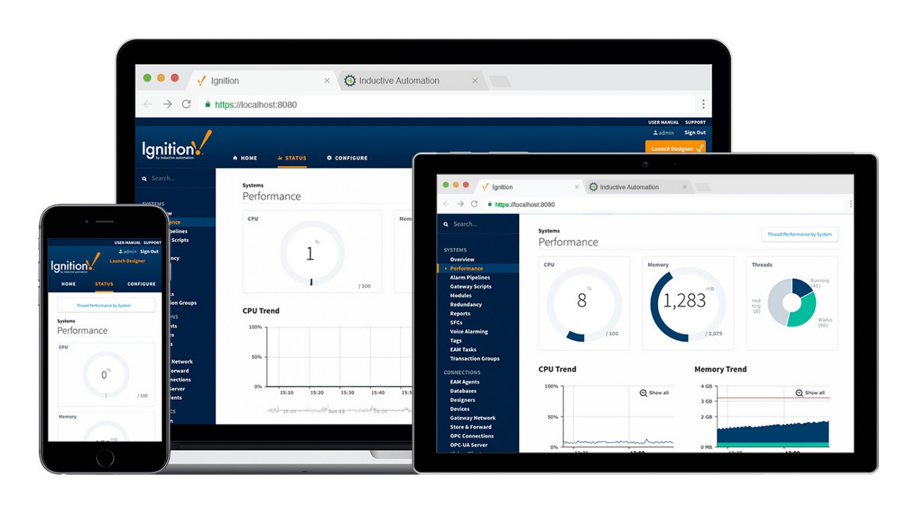

Slide 29
That communication data is routed from the processors to the SCADA computers, where the software interprets and displays the data allowing for operators to analyze and react to system events. Before SCADA, plant personnel had to monitor and control industrial processes via selector switches, push buttons, and dials for analog signals. This meant that plants had to maintain personnel on site, during production, in order to control the processes. As manufacturing grew and sites became more remote in nature, relays and timers were used to assist in the supervision and control of processes.

Slide 30
Difference between HMI and SCADA
Supervisory Control and Data Acquisition (SCADA) and HMI are closely related, and often referred to in the same context since they are both part of a larger industrial control system, but they each offer different functionality and opportunities. While HMIs are focused on visually conveying information to help the user supervise an industrial process, SCADA systems have a greater capacity for data collection and control-system operation. Unlike SCADA systems, HMIs do not collect and record information or connect to databases. Rather, HMI provides an effective communication tool that functions as part of, or alongside, a SCADA system.
https://www.youtube.com/watch?v=xvVCSYt_YsQ

Slide 31
Discussion Topics
A welding Robot cell interfacing.
Handling Robot cell interfacing.

